Slide 1
Feedback Analysis for Online Food Sellers
Helping online sellers know what to expect from their listings on Amazon

Slide 2
overview
Exploratory Analysis
NLP: Text Preprocessing
Feature Engineering for Supervised Models
Feature extraction
Under-sampling
Baseline Models
Logistic Regression: TF-IDF (Balanced Data)
Logistic Regression: TF-IDF (Original Data)
Logistic Regression: BoW (Original Data)
Supervised ML Algorithms
Random Forest Classifier
XGBoost
LightGBM
Deep Learning: Building Models with Keras
DNN
RNN (LSTM)
CNN
Model Evaluation
Result
References

Slide 3
What is sentiment?
Known as opinion mining, “Sentiment analysis” is a process of identifying and cataloging a piece of text according to the tone conveyed by it.
Sentiment can be:
- Positive
- Negative
- Neutral
The accuracy can never be 100%. And of course, a machine does not understand sarcasm or humor. However, according to a research, people do not agree 80% of the time. It means that even if the machine accuracy does not score a perfect 100, it will still be more accurate than human analysis.

Slide 4
sentiment analysis Business Impact
Business Intelligence Buildup
Competitive Advantage
Enhancing Customer Experience
Brand Brisking
Notes:
Business Intelligence Buildup: With the sentiment data about your established and the new products, it’s easier to estimate your customer retention rate. Based on the reviews generated through sentiment analysis in business, you can always adjust to the present market situation and satisfy your customers in a better way.
Competitive advantage: Knowing the sentiment data of your competitors gives you the opportunity as well as the incentive to perk up your performance. Sentiment analysis in businesses can be very helpful in predicting the customer trends.
Enhancing Customer Experience: The tone and temperament of this data can be detected and then categorized according to the sentiments attached. This helps to know what is being properly implemented with regards to products, services and customer support and what needs improvement.
Brand Brisking: The name and fame that build a brand majorly depend on their online marketing, social campaigning, content marketing and customer support services. Sentiment analysis in business helps in quantifying the perception of the present and the potential customers regarding all these factors. Keeping the negative sentiments in knowledge, you can develop more appealing branding techniques and marketing strategies to switch from torpid to terrific brand status. Sentiment analysis in business can majorly help you to make a quick transition.

Slide 5
Amazon Fine Food Reviews
Reviews.csv:
Pulled from the corresponding SQLite table named ‘Reviews’ in database.sqlite
Content:
Id: Row Id
ProductId: Unique identifier for the product
UserId: Unqiue identifier for the user
ProfileName: Profile name of the user
HelpfulnessNumerator: Number of users who found the review helpful
HelpfulnessDenominator: Number of users who indicated whether they found the review helpful or not
Source: https://www.kaggle.com/snap/amazon-fine-food-reviews

Slide 6

Exploratory analysis

Slide 7
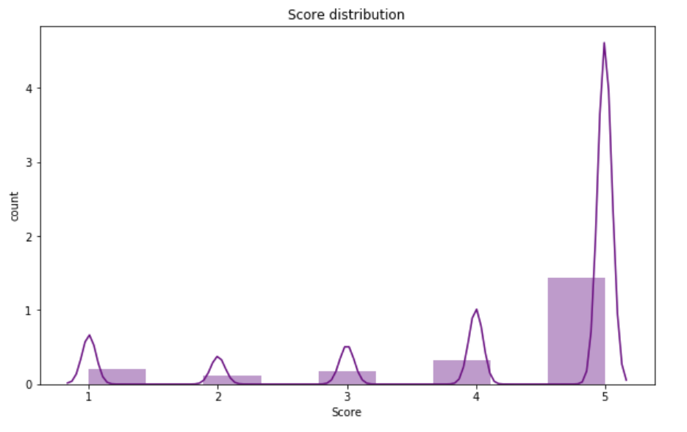
Score distribution
Most of reviews are scored 4 and above
Mean score is 4.18
This can indicate that most people are just happy with their purchase
It also indicates the imbalanced sentiment distribution.

Slide 8
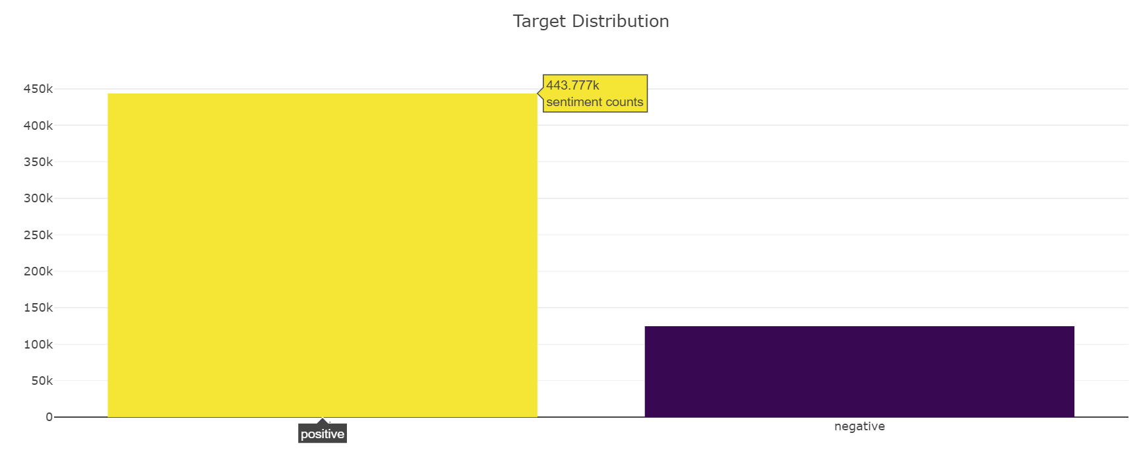
Target distribution
Class imbalance:
Positive: 78.07%
Negative: 21.93%
Target distribution count:
Positive: 443,777
Negative: 124,677

Slide 9
NLP: Text Processing

Slide 10
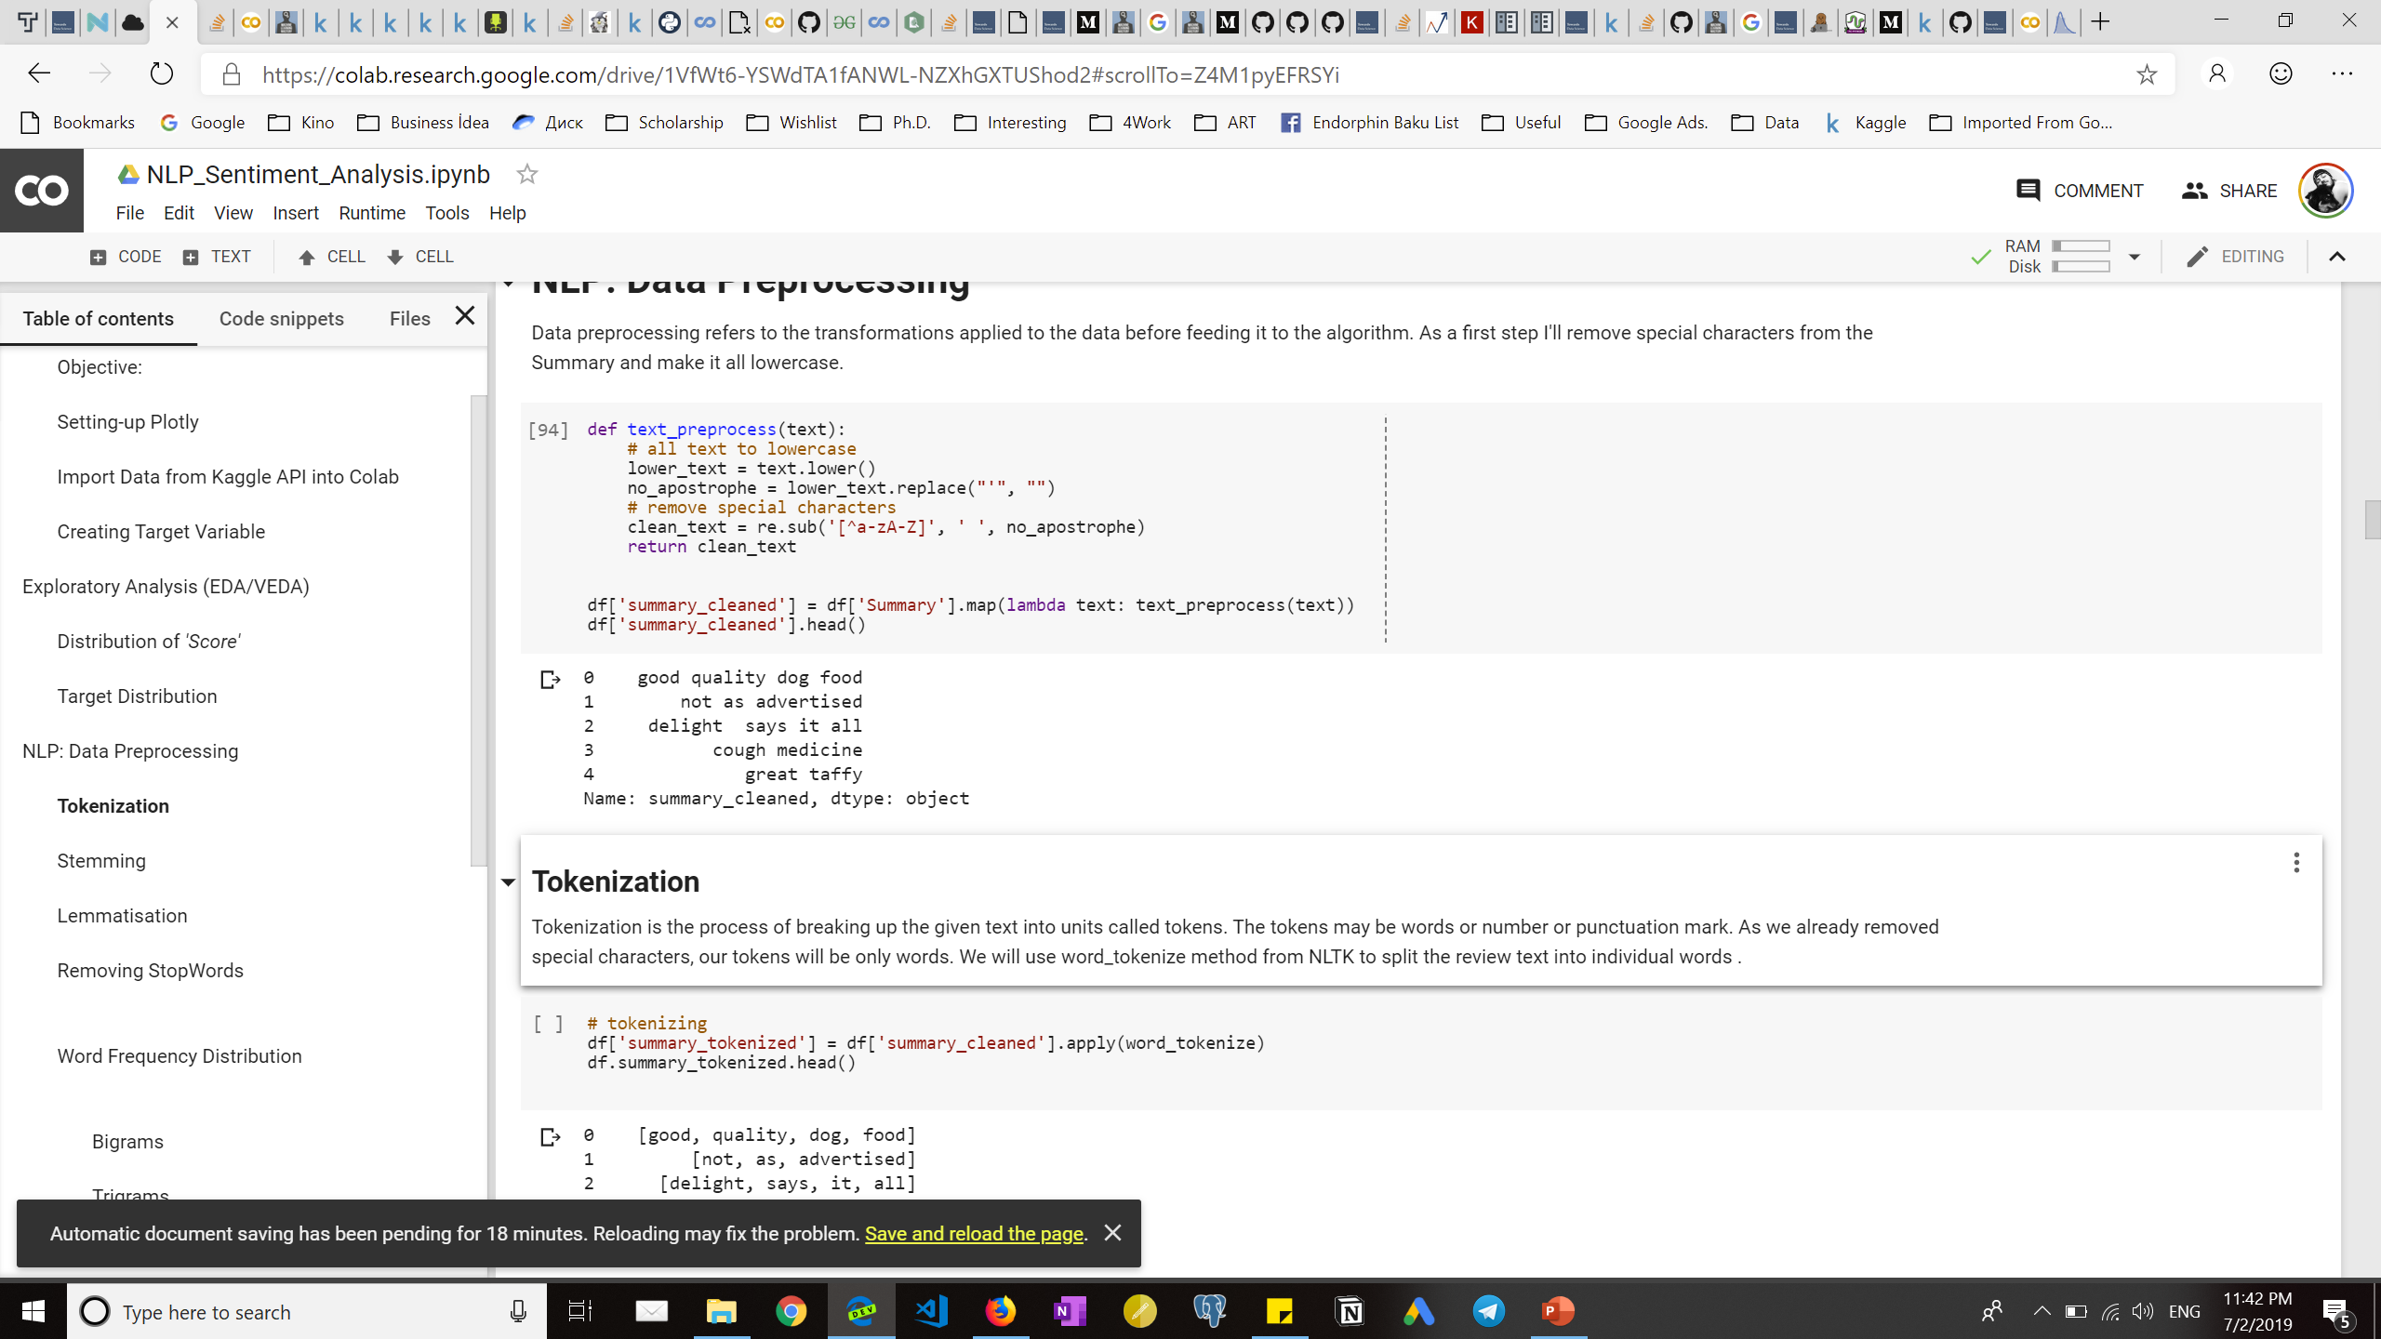
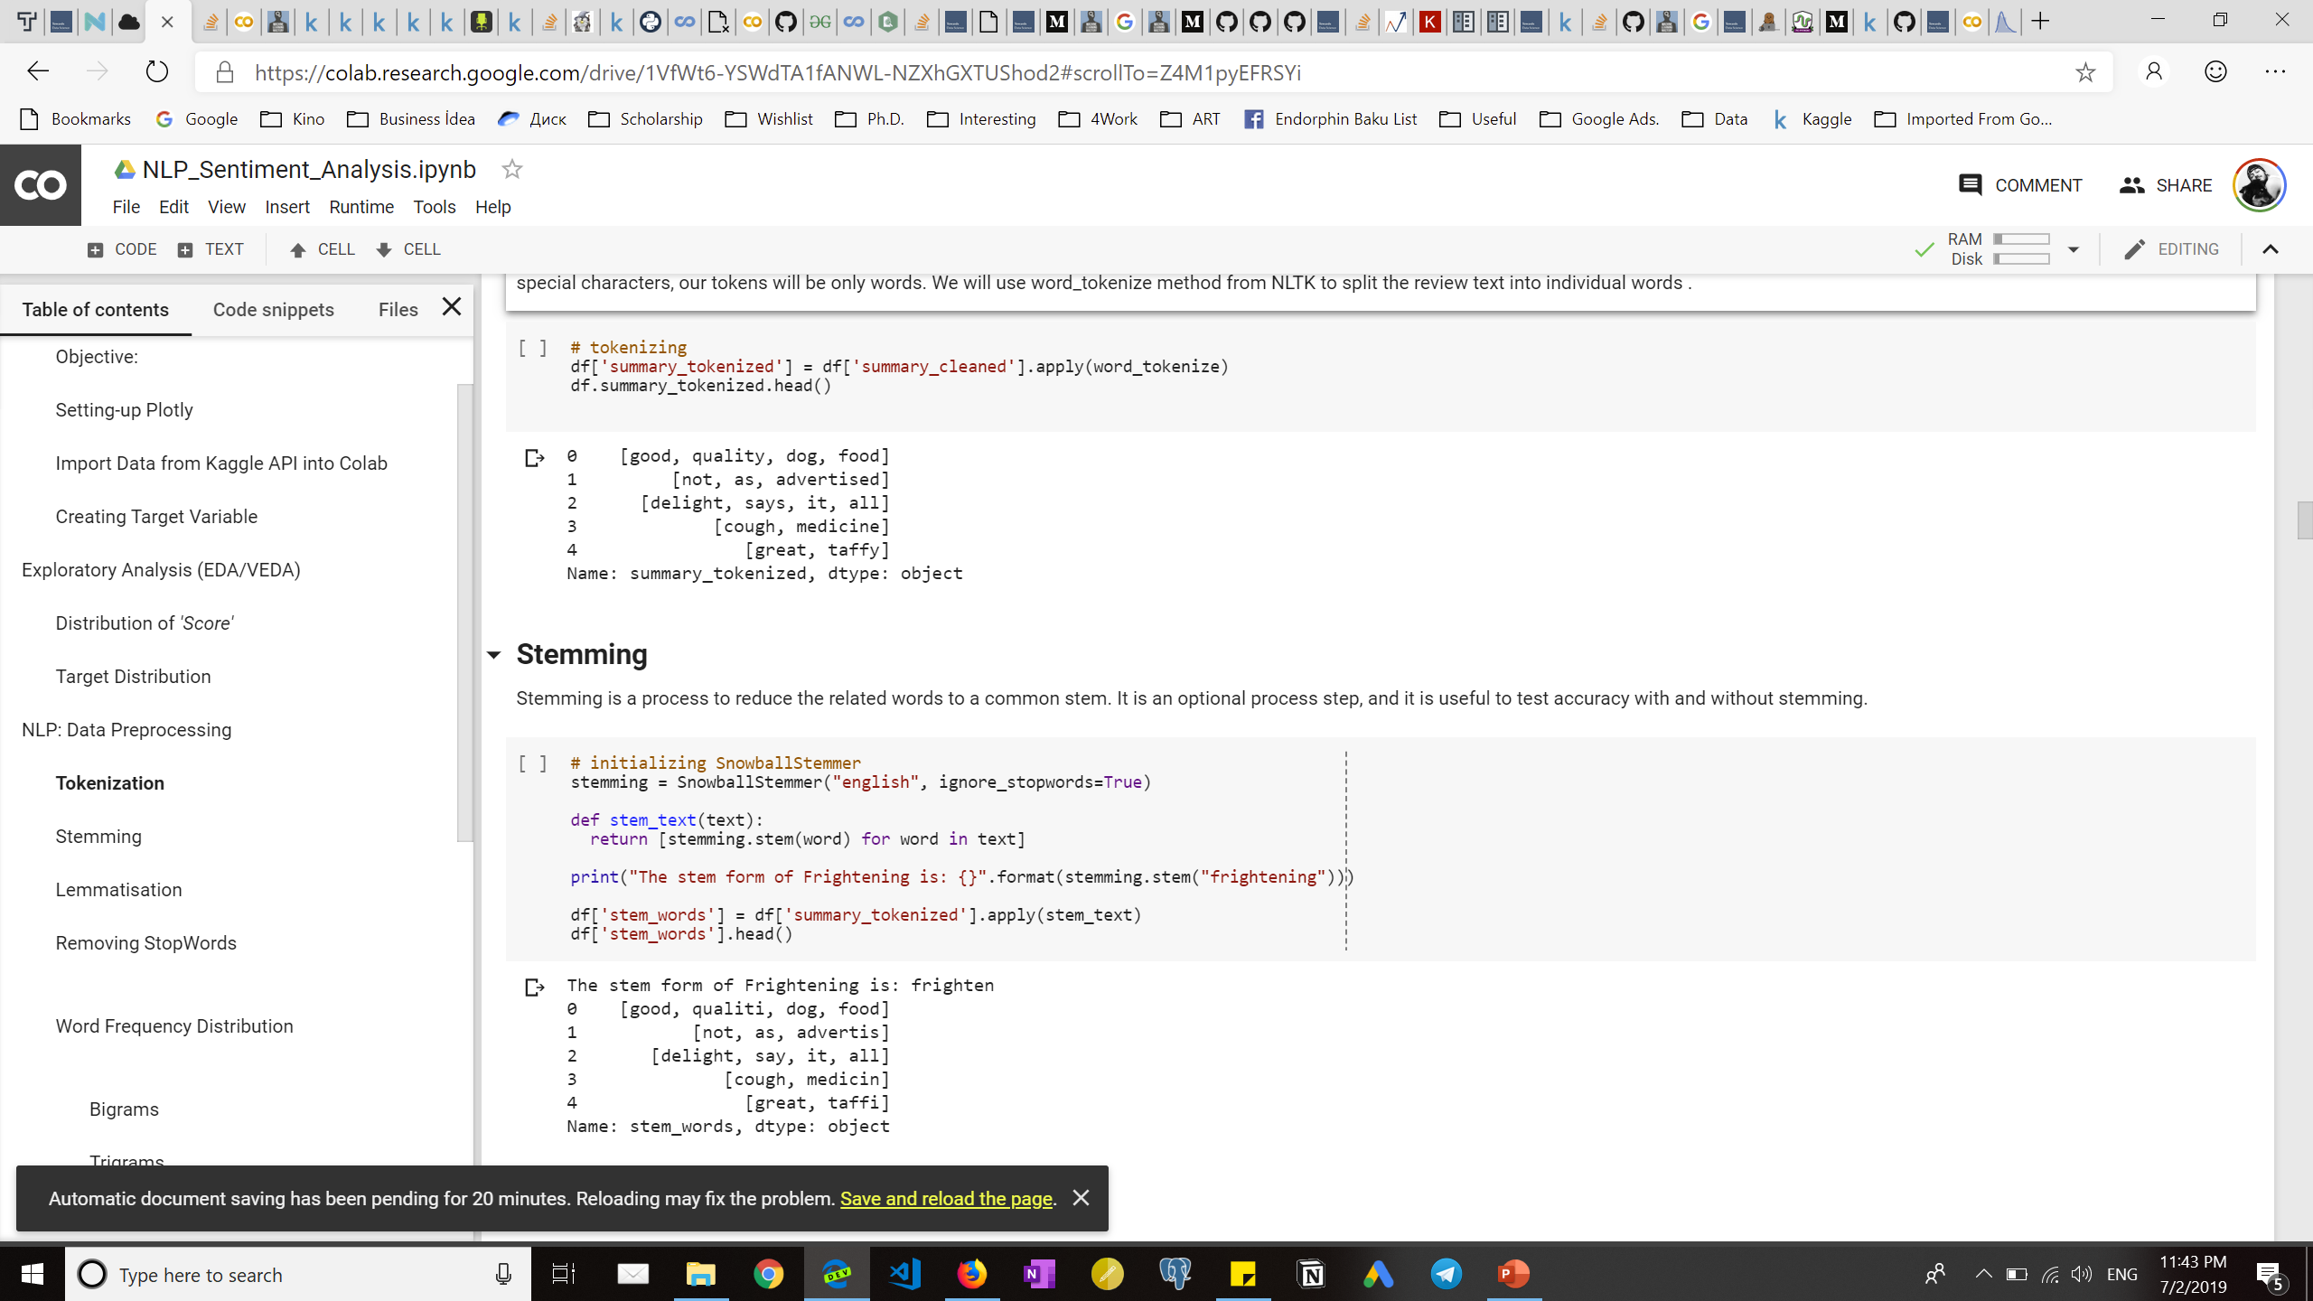
tokenization
tokenization
A process of breaking up a text into units called “Tokens”
word_tokenize() method from NLTK library
before
After

Slide 11
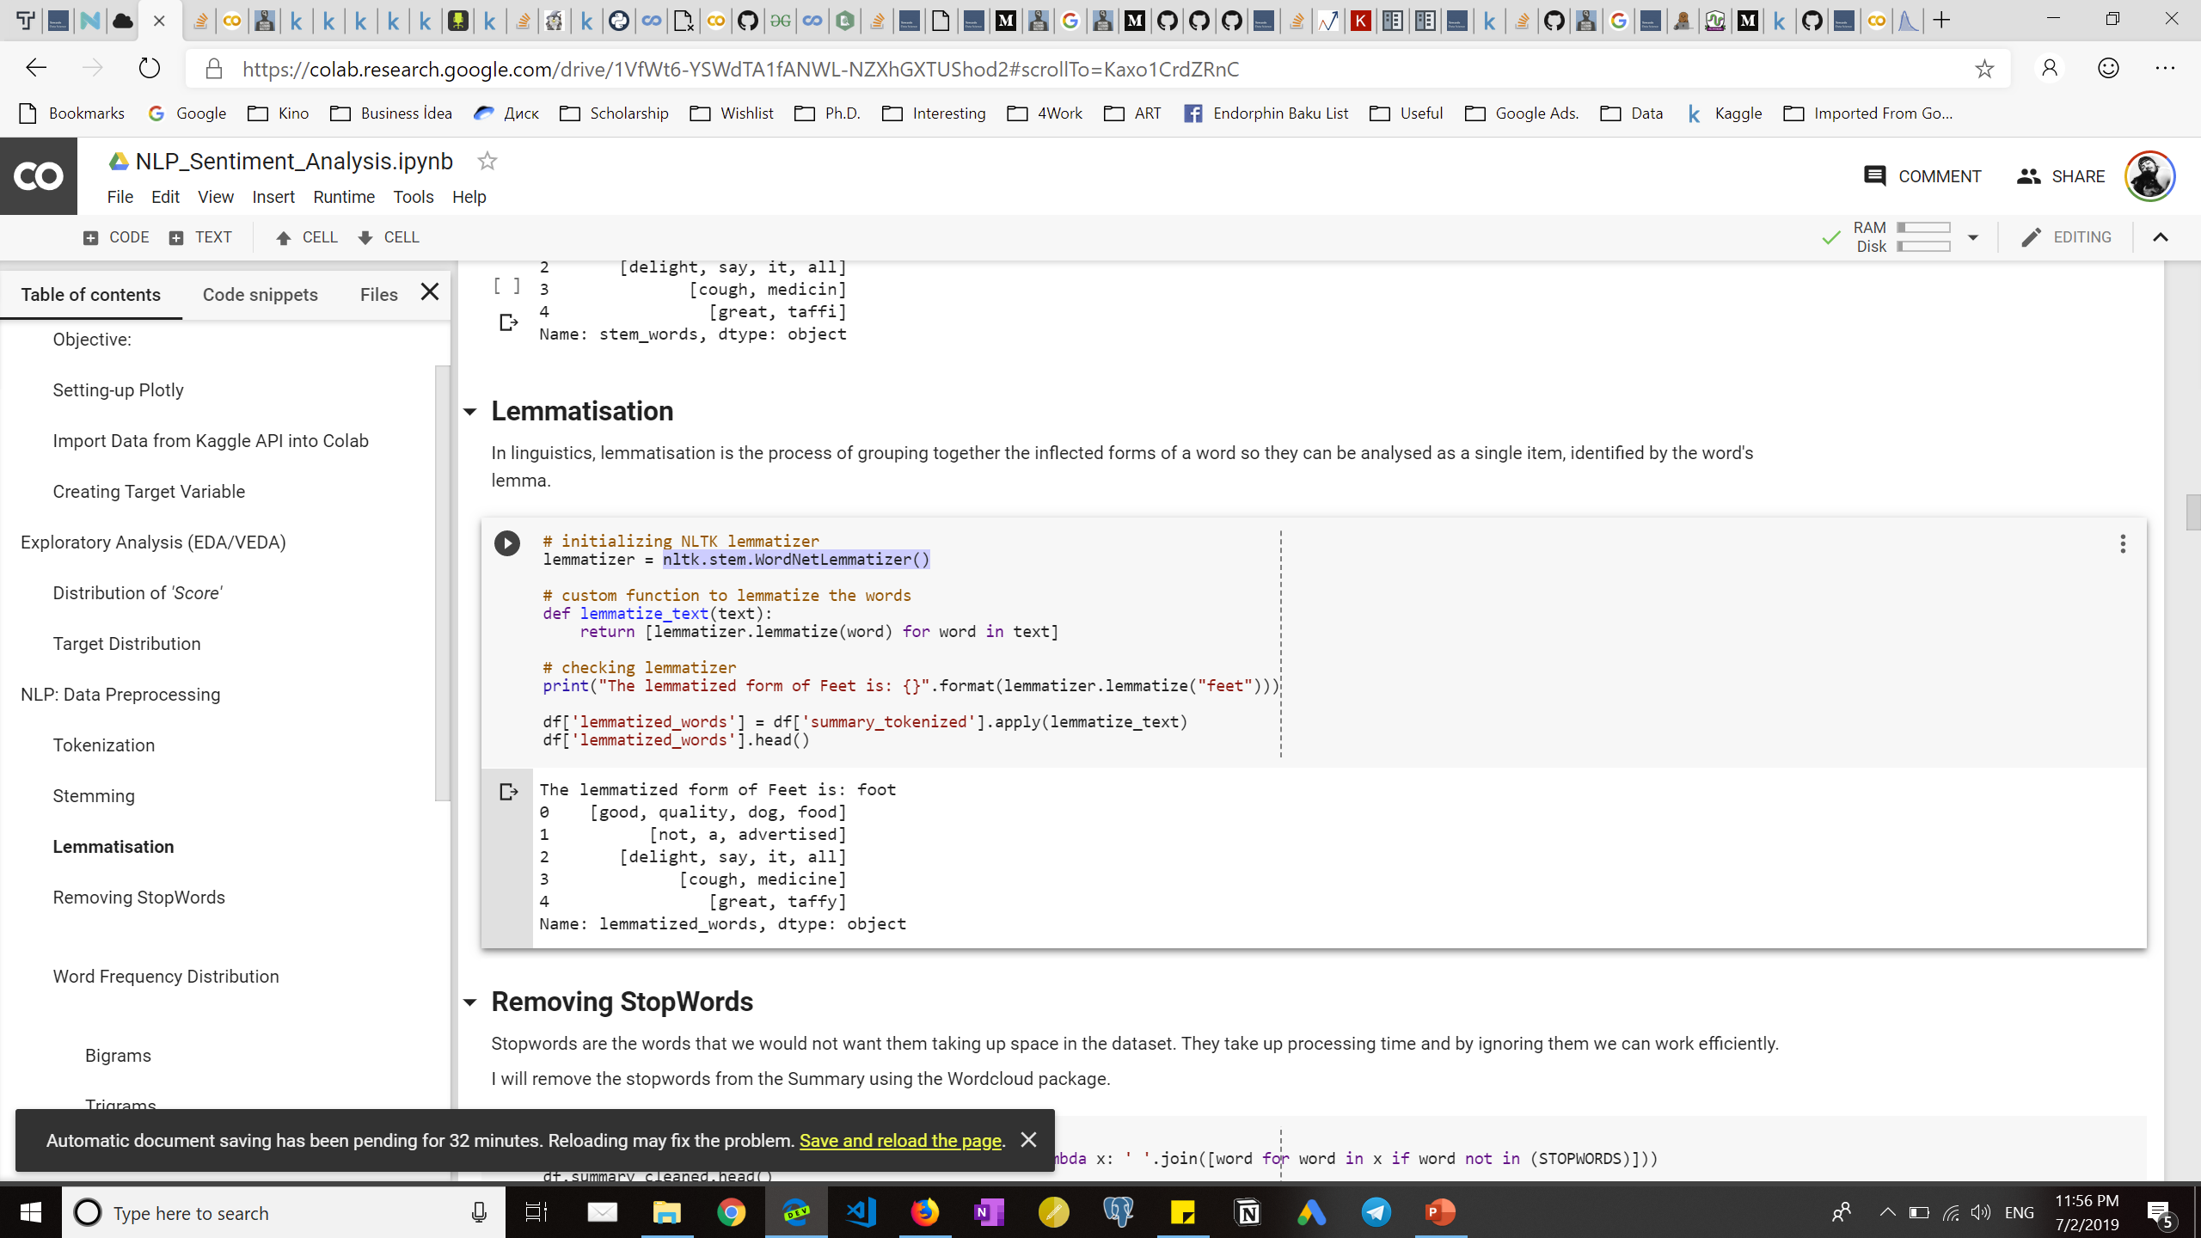
Lemmatization
A process of grouping together the inflected forms of a word
WordNetLemmatizer() method from NLTK library
Example:

Slide 12
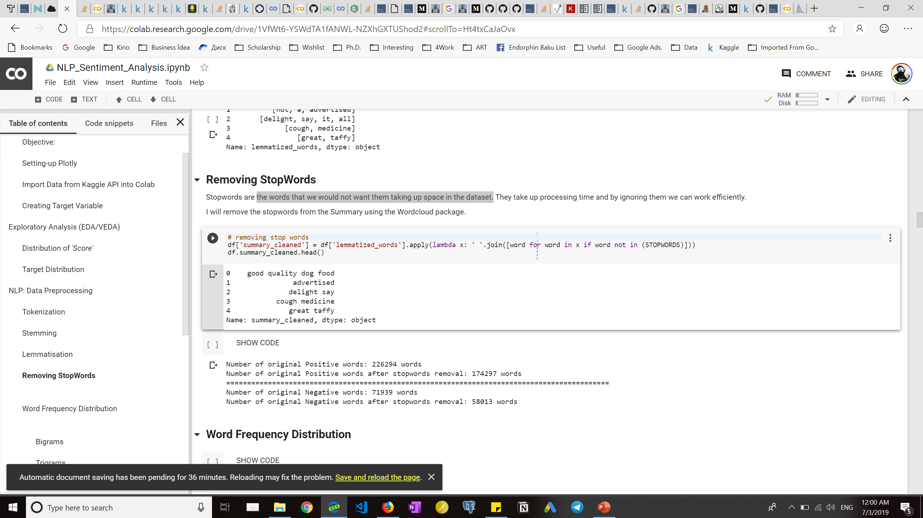

Removing stopwords
The words that we would not want them taking up space in the dataset. S
STOPWORDS from WordCloud library
before
after

Slide 13

Text data exploration

Slide 14
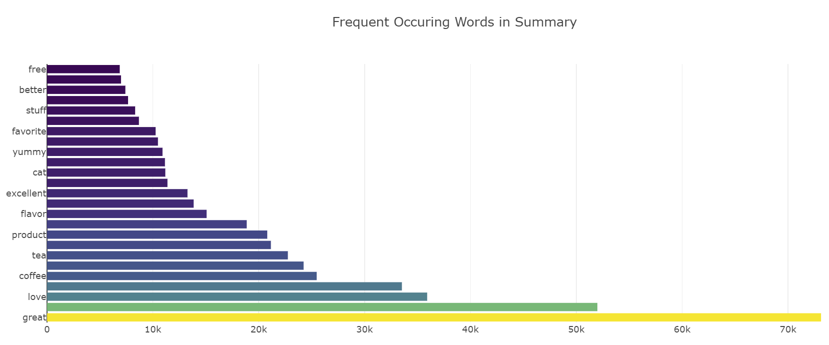
Word frequency distribution
As positive reviews dominate, most frequent words are representing positive sentiment

Slide 15
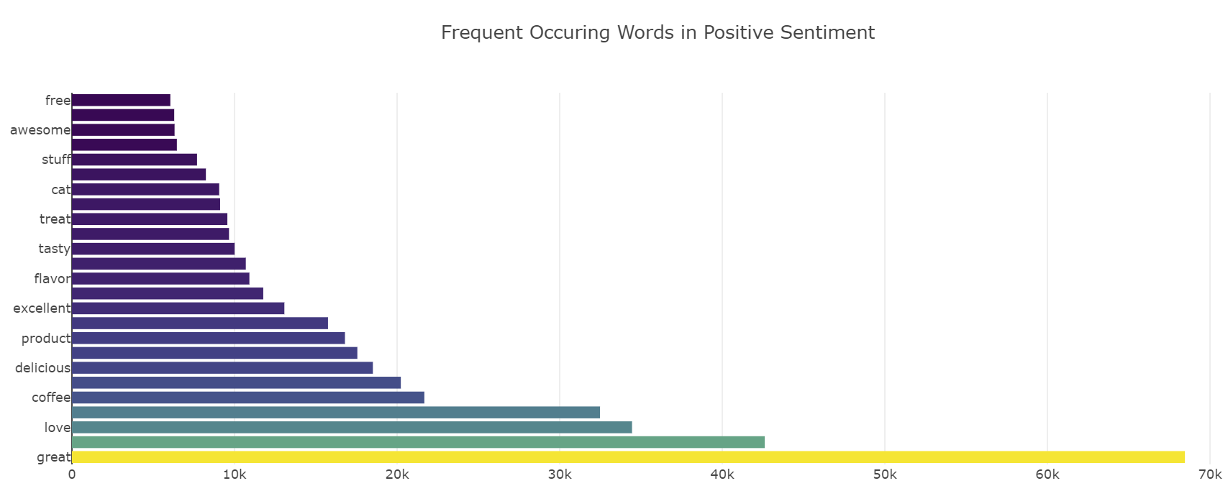
Word frequency in positive sentiment

Slide 16
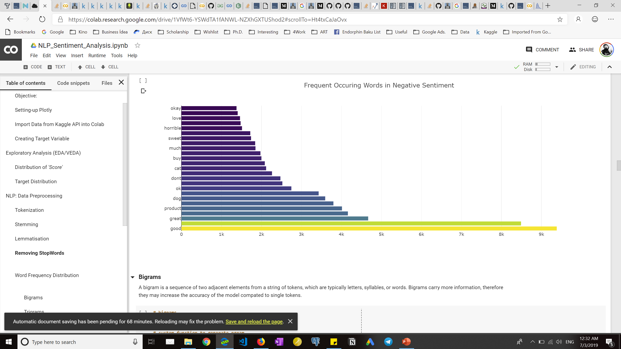
Word frequency in negative sentiment
Some positive words can be observed as a negative sentiment

Slide 17
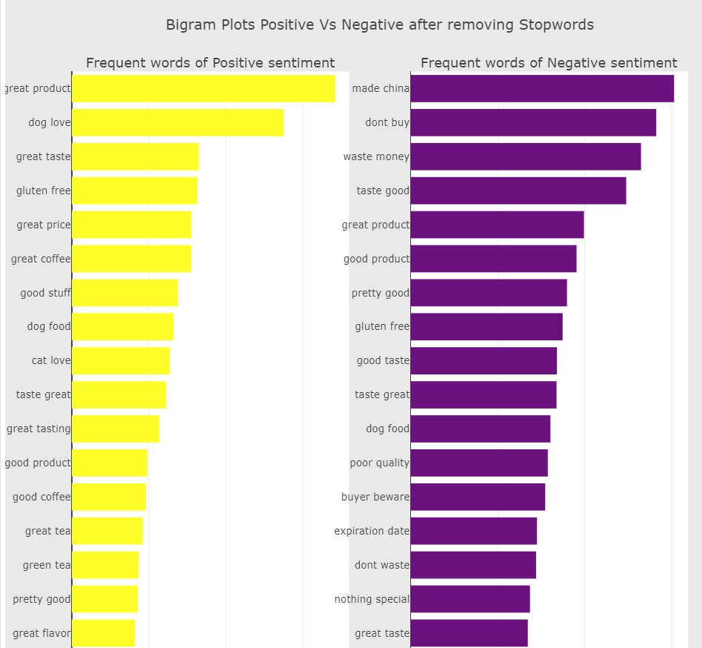
Bigrams
A sequence of two adjacent elements from a string of tokens
Observations:
If we look at the bigrams in negative sentiment, there are some combinations which don't look negative:
taste great, gluten free, good product, great product, good taste

Slide 18
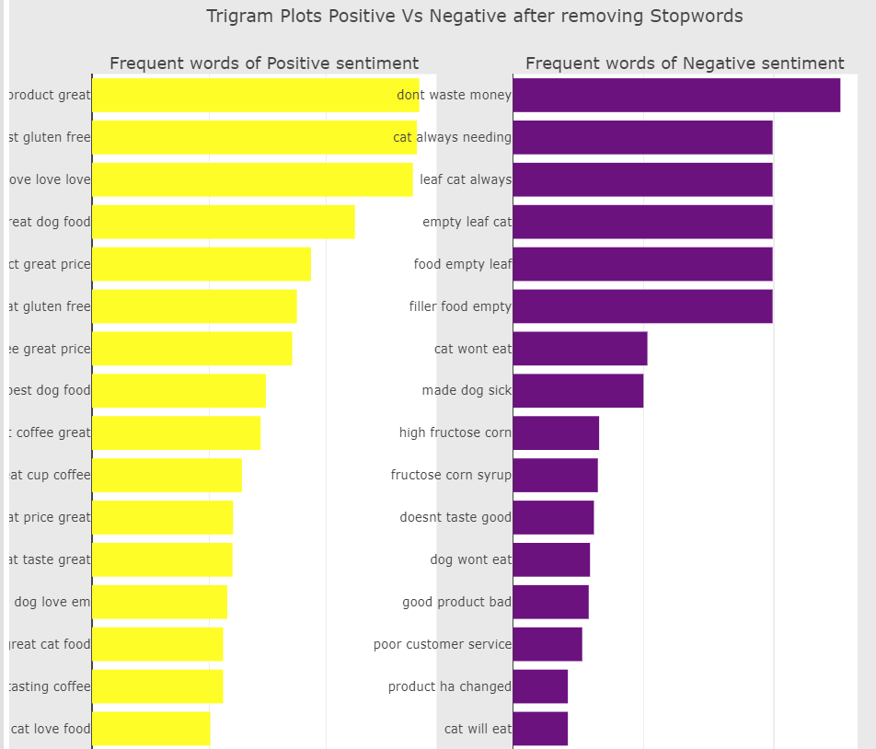
trigrams
A sequence of three adjacent elements from a string of tokens
Observations:
With trigrams, we can tell about the sentiment more accurate than with bigrams.

Slide 19
Data preparation

Slide 20
Feature engineering
Bag of Words (BoW)
In this model, a text (such as a sentence or a document) is represented as the bag (multiset) of its words.
CountVectorizer() method from sklearn library
TF-IDF
short for term frequency–inverse document frequency, is a numerical statistic that is intended to reflect how important a word is to a document in a collection or corpus.
TfidfTransformer() method from sklearn library

Slide 21
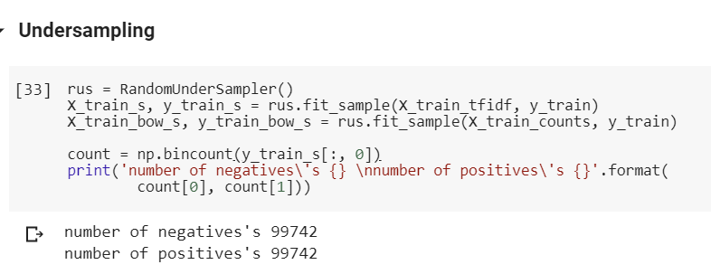
undersampling
Since the dataset is enough large, undersampling the majority class would be computationally less costly and allow us to test even long-to-run algorithms.

Slide 22
Baseline models

Slide 23
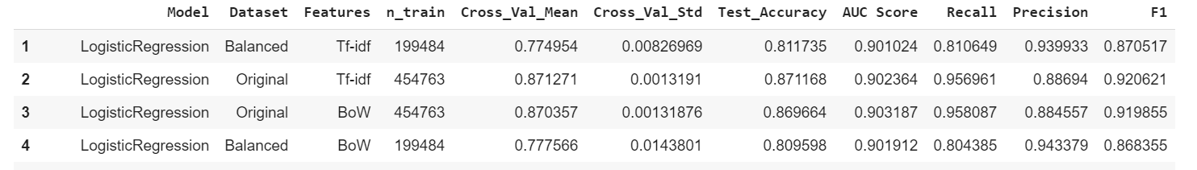
Feature and dataset selection
Observation:
Judging by cross-validation means, balanced datasets are more tend to overfit than the original one. And if consider F1 and AUC scores for the models trained on original datasets, we can say that the TF-IDF features are good to continue testing other algorithms on.

Slide 24

modeling

Slide 25
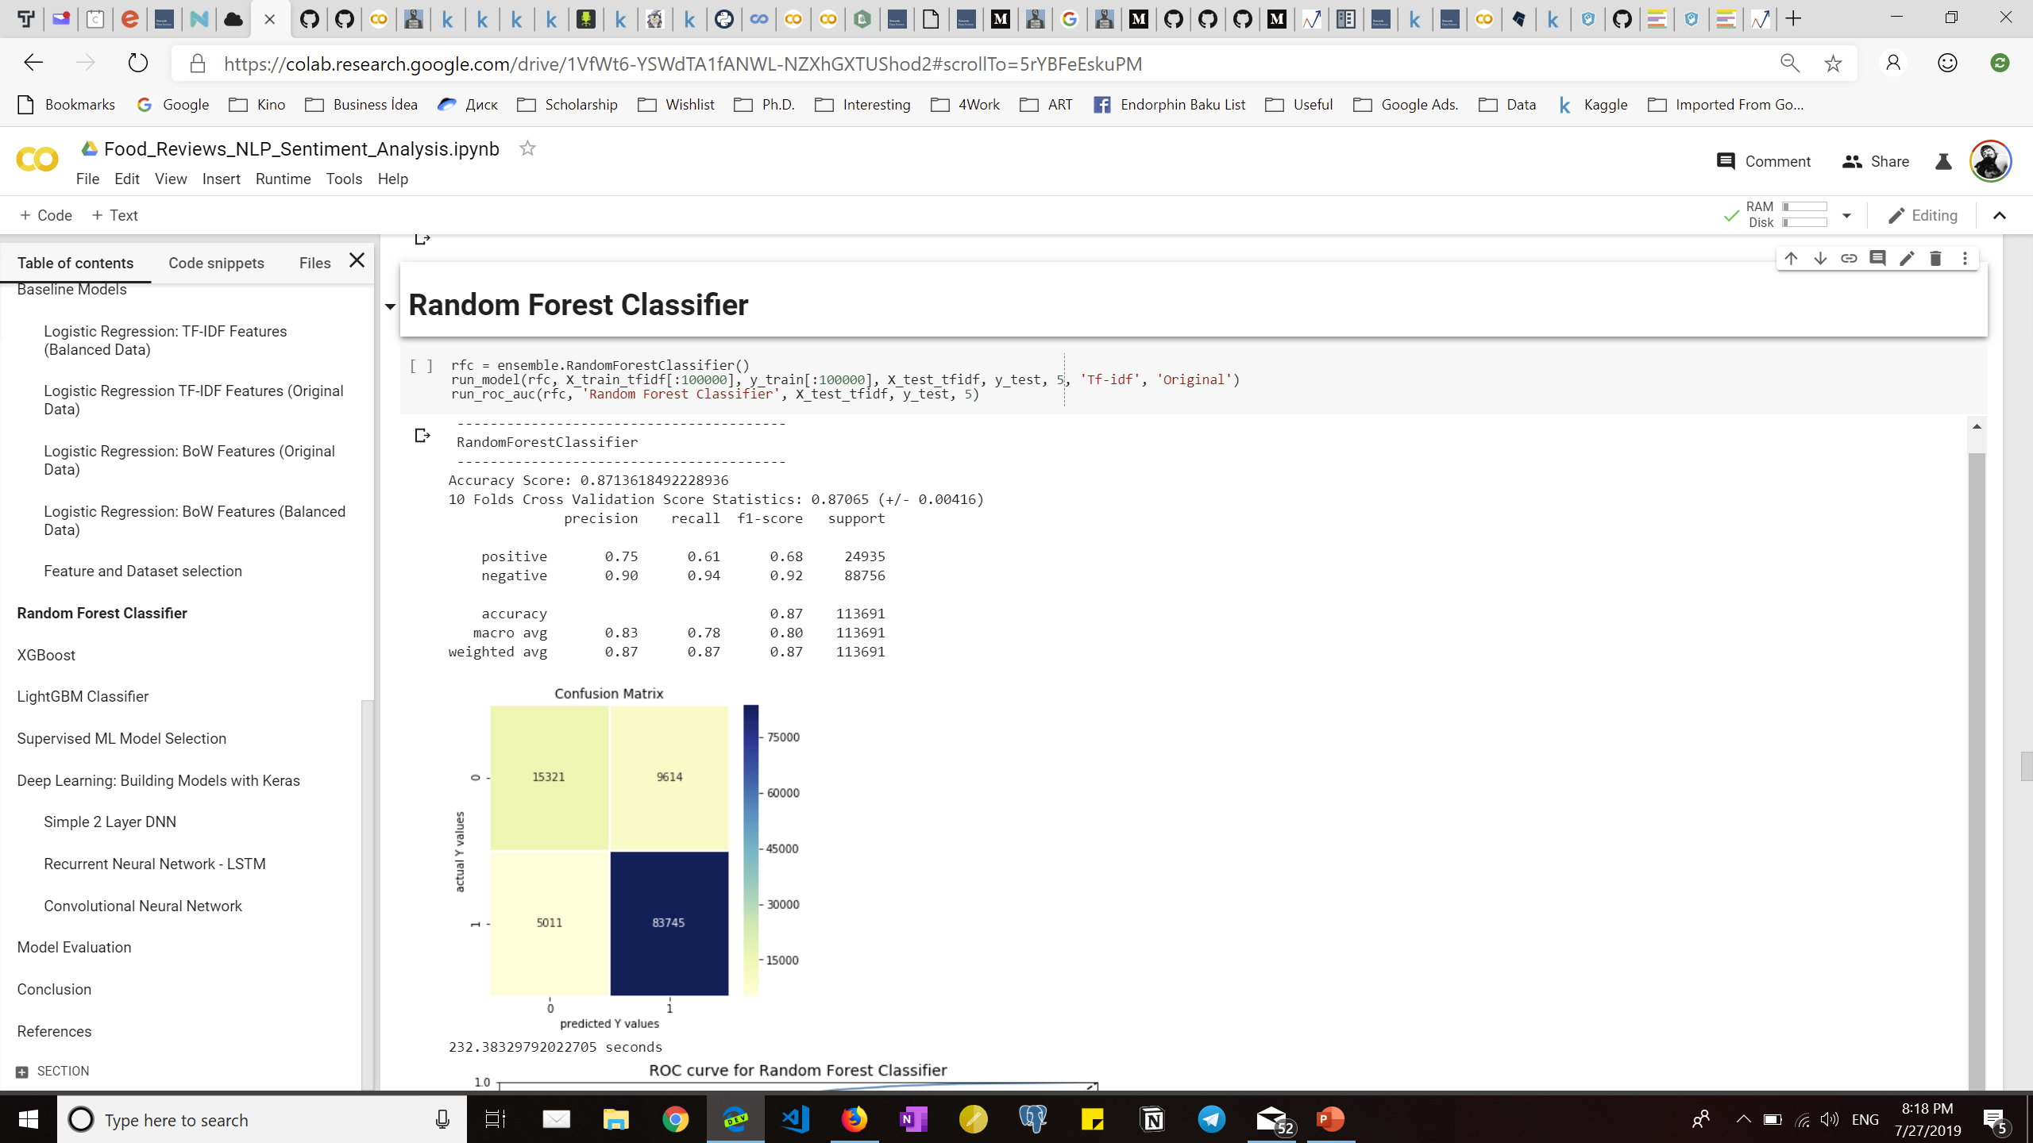
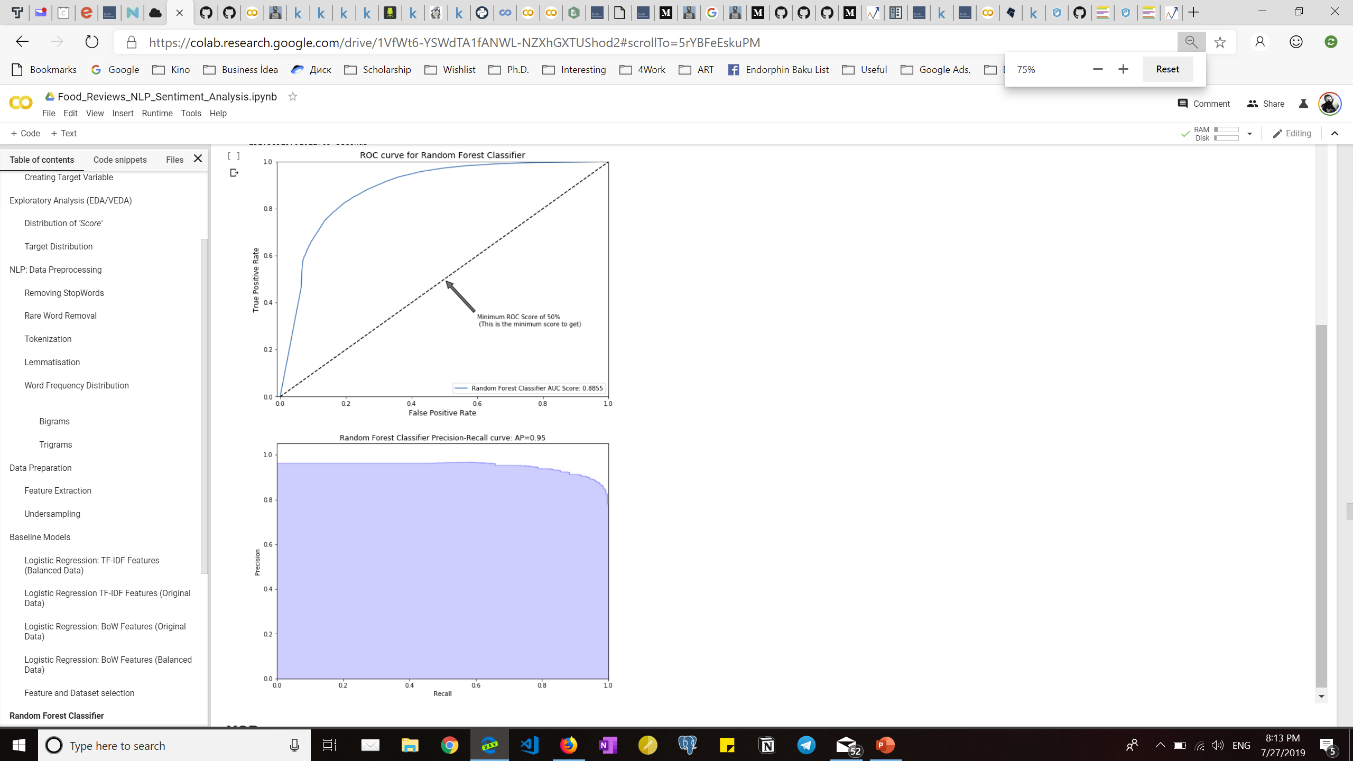
Random forest classifier

Slide 26
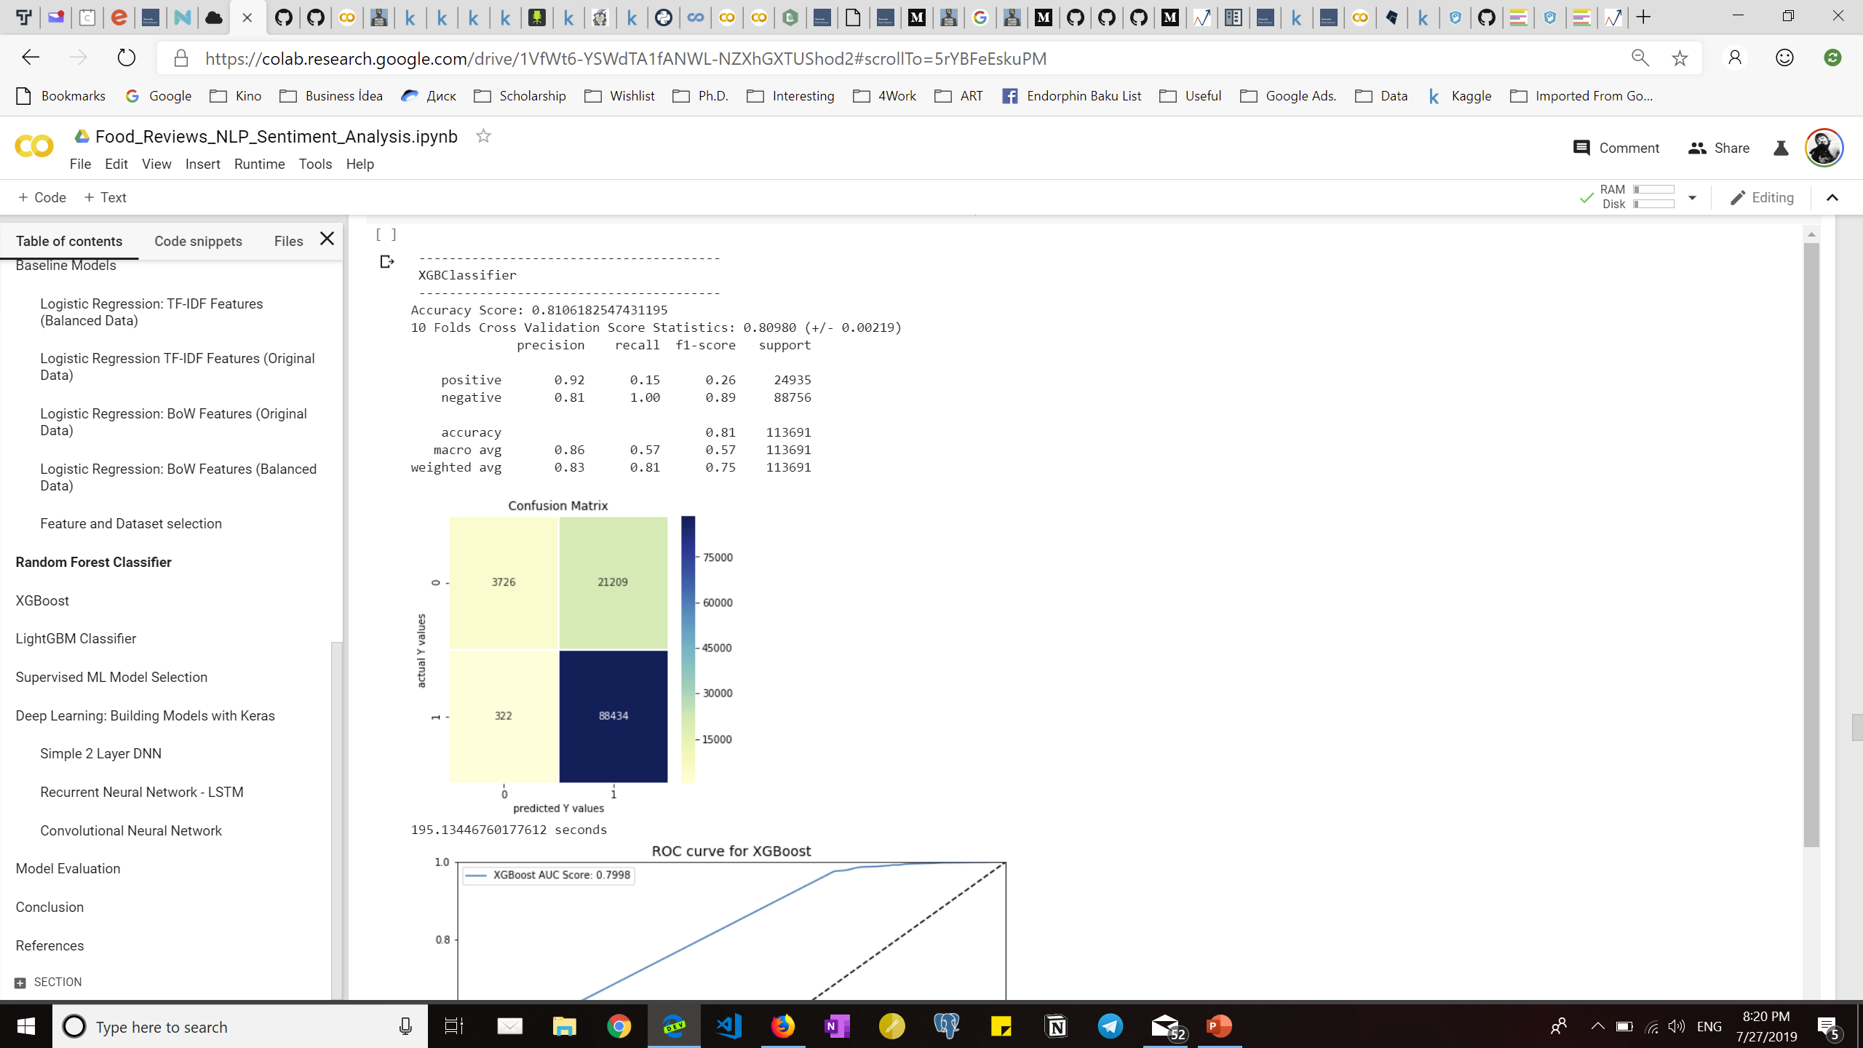
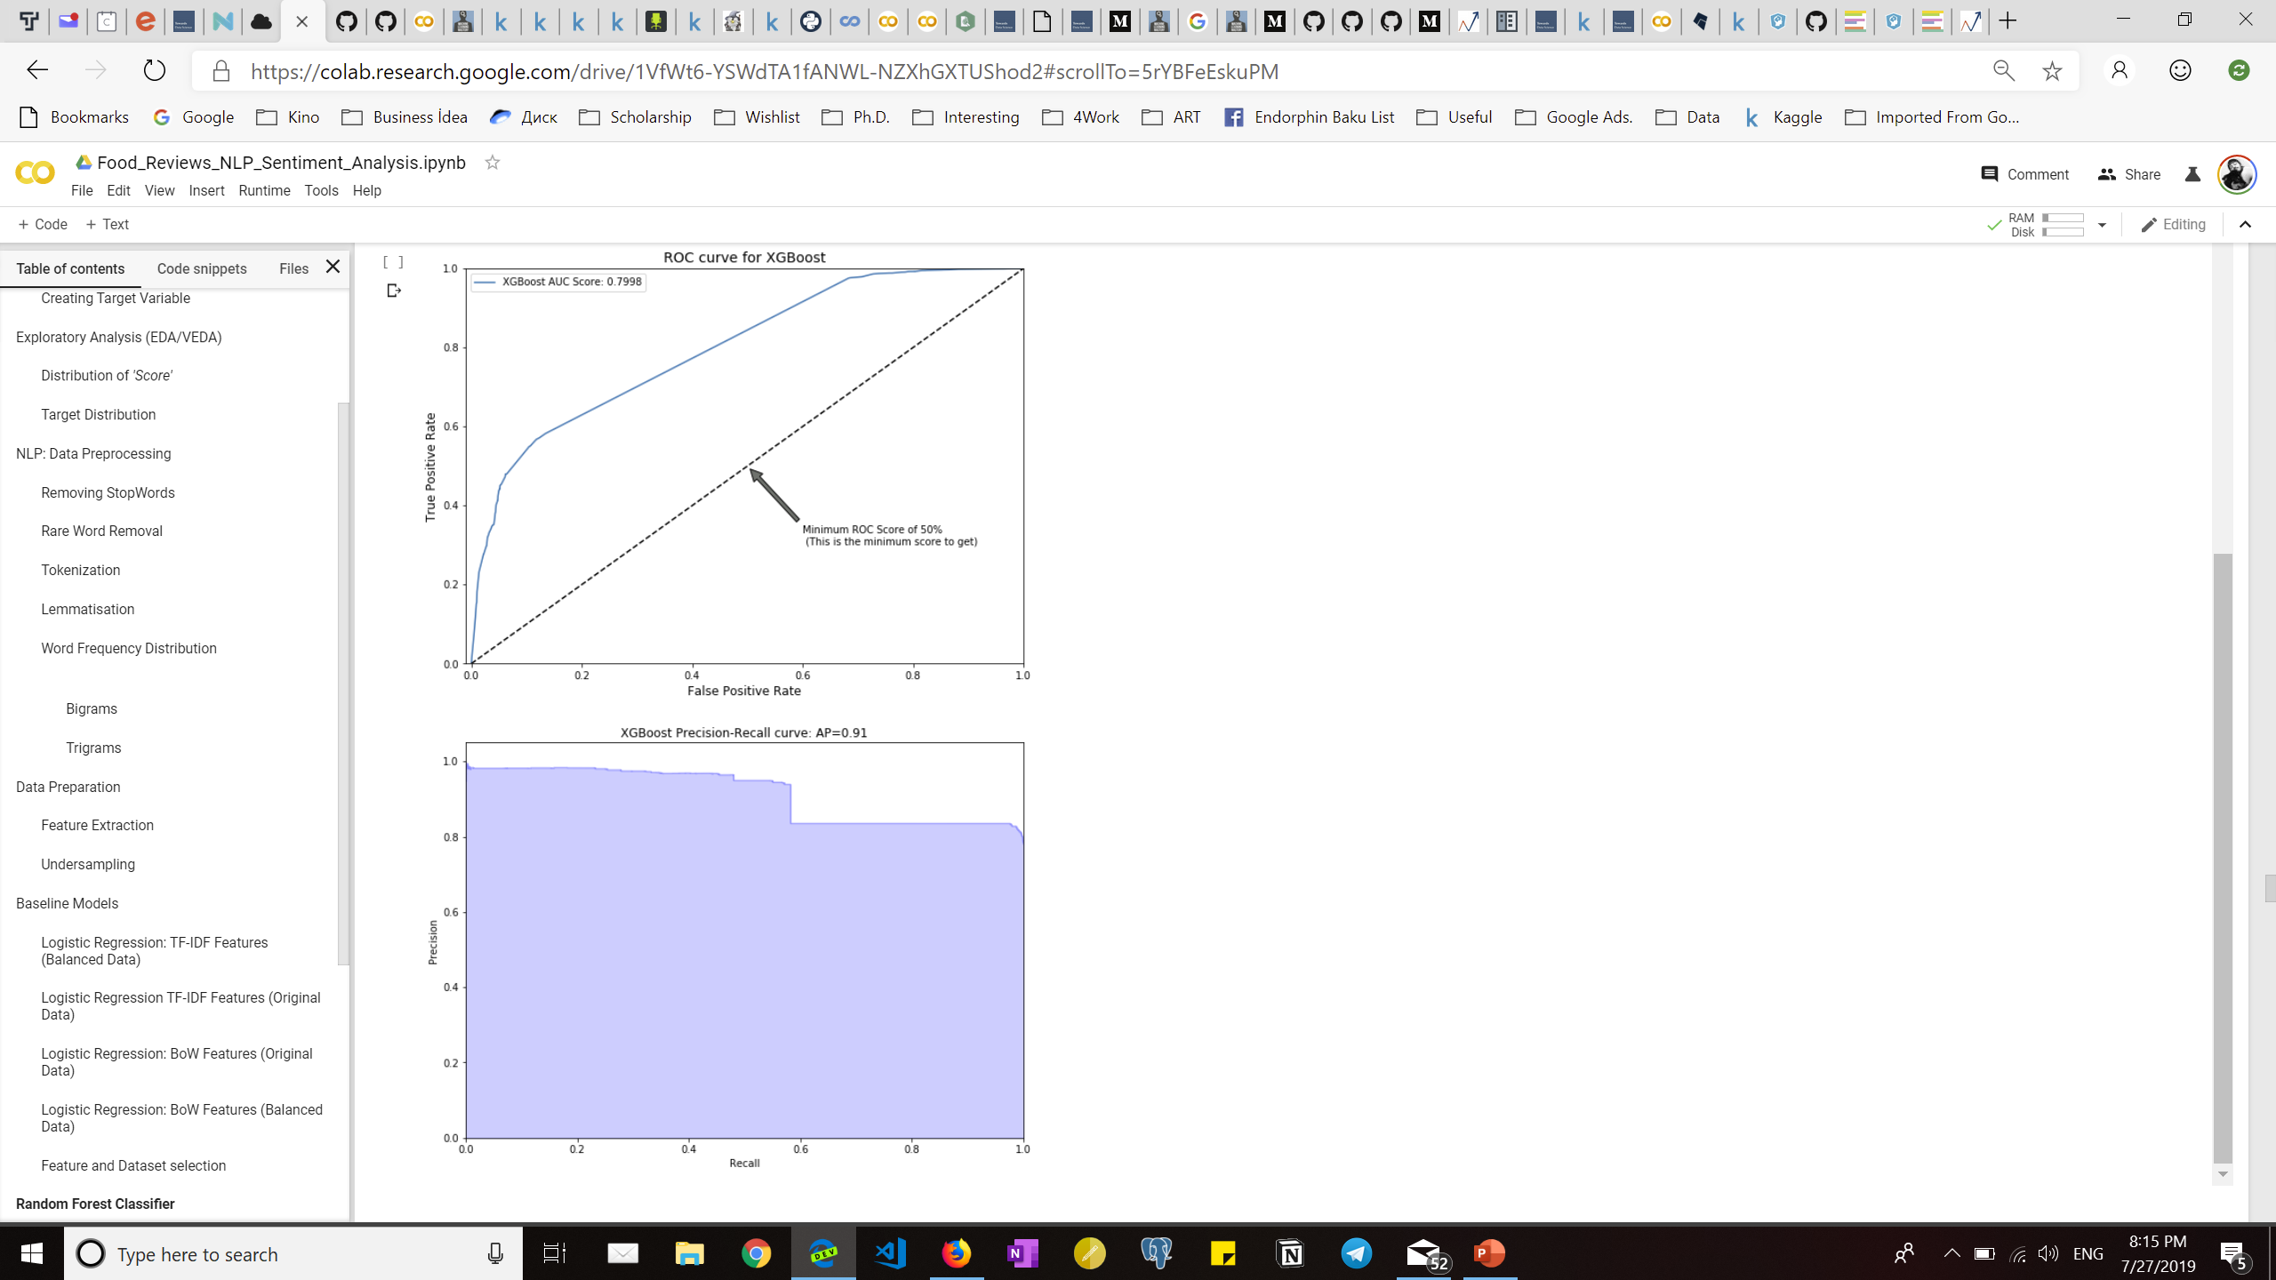
XGBoost classifier

Slide 27
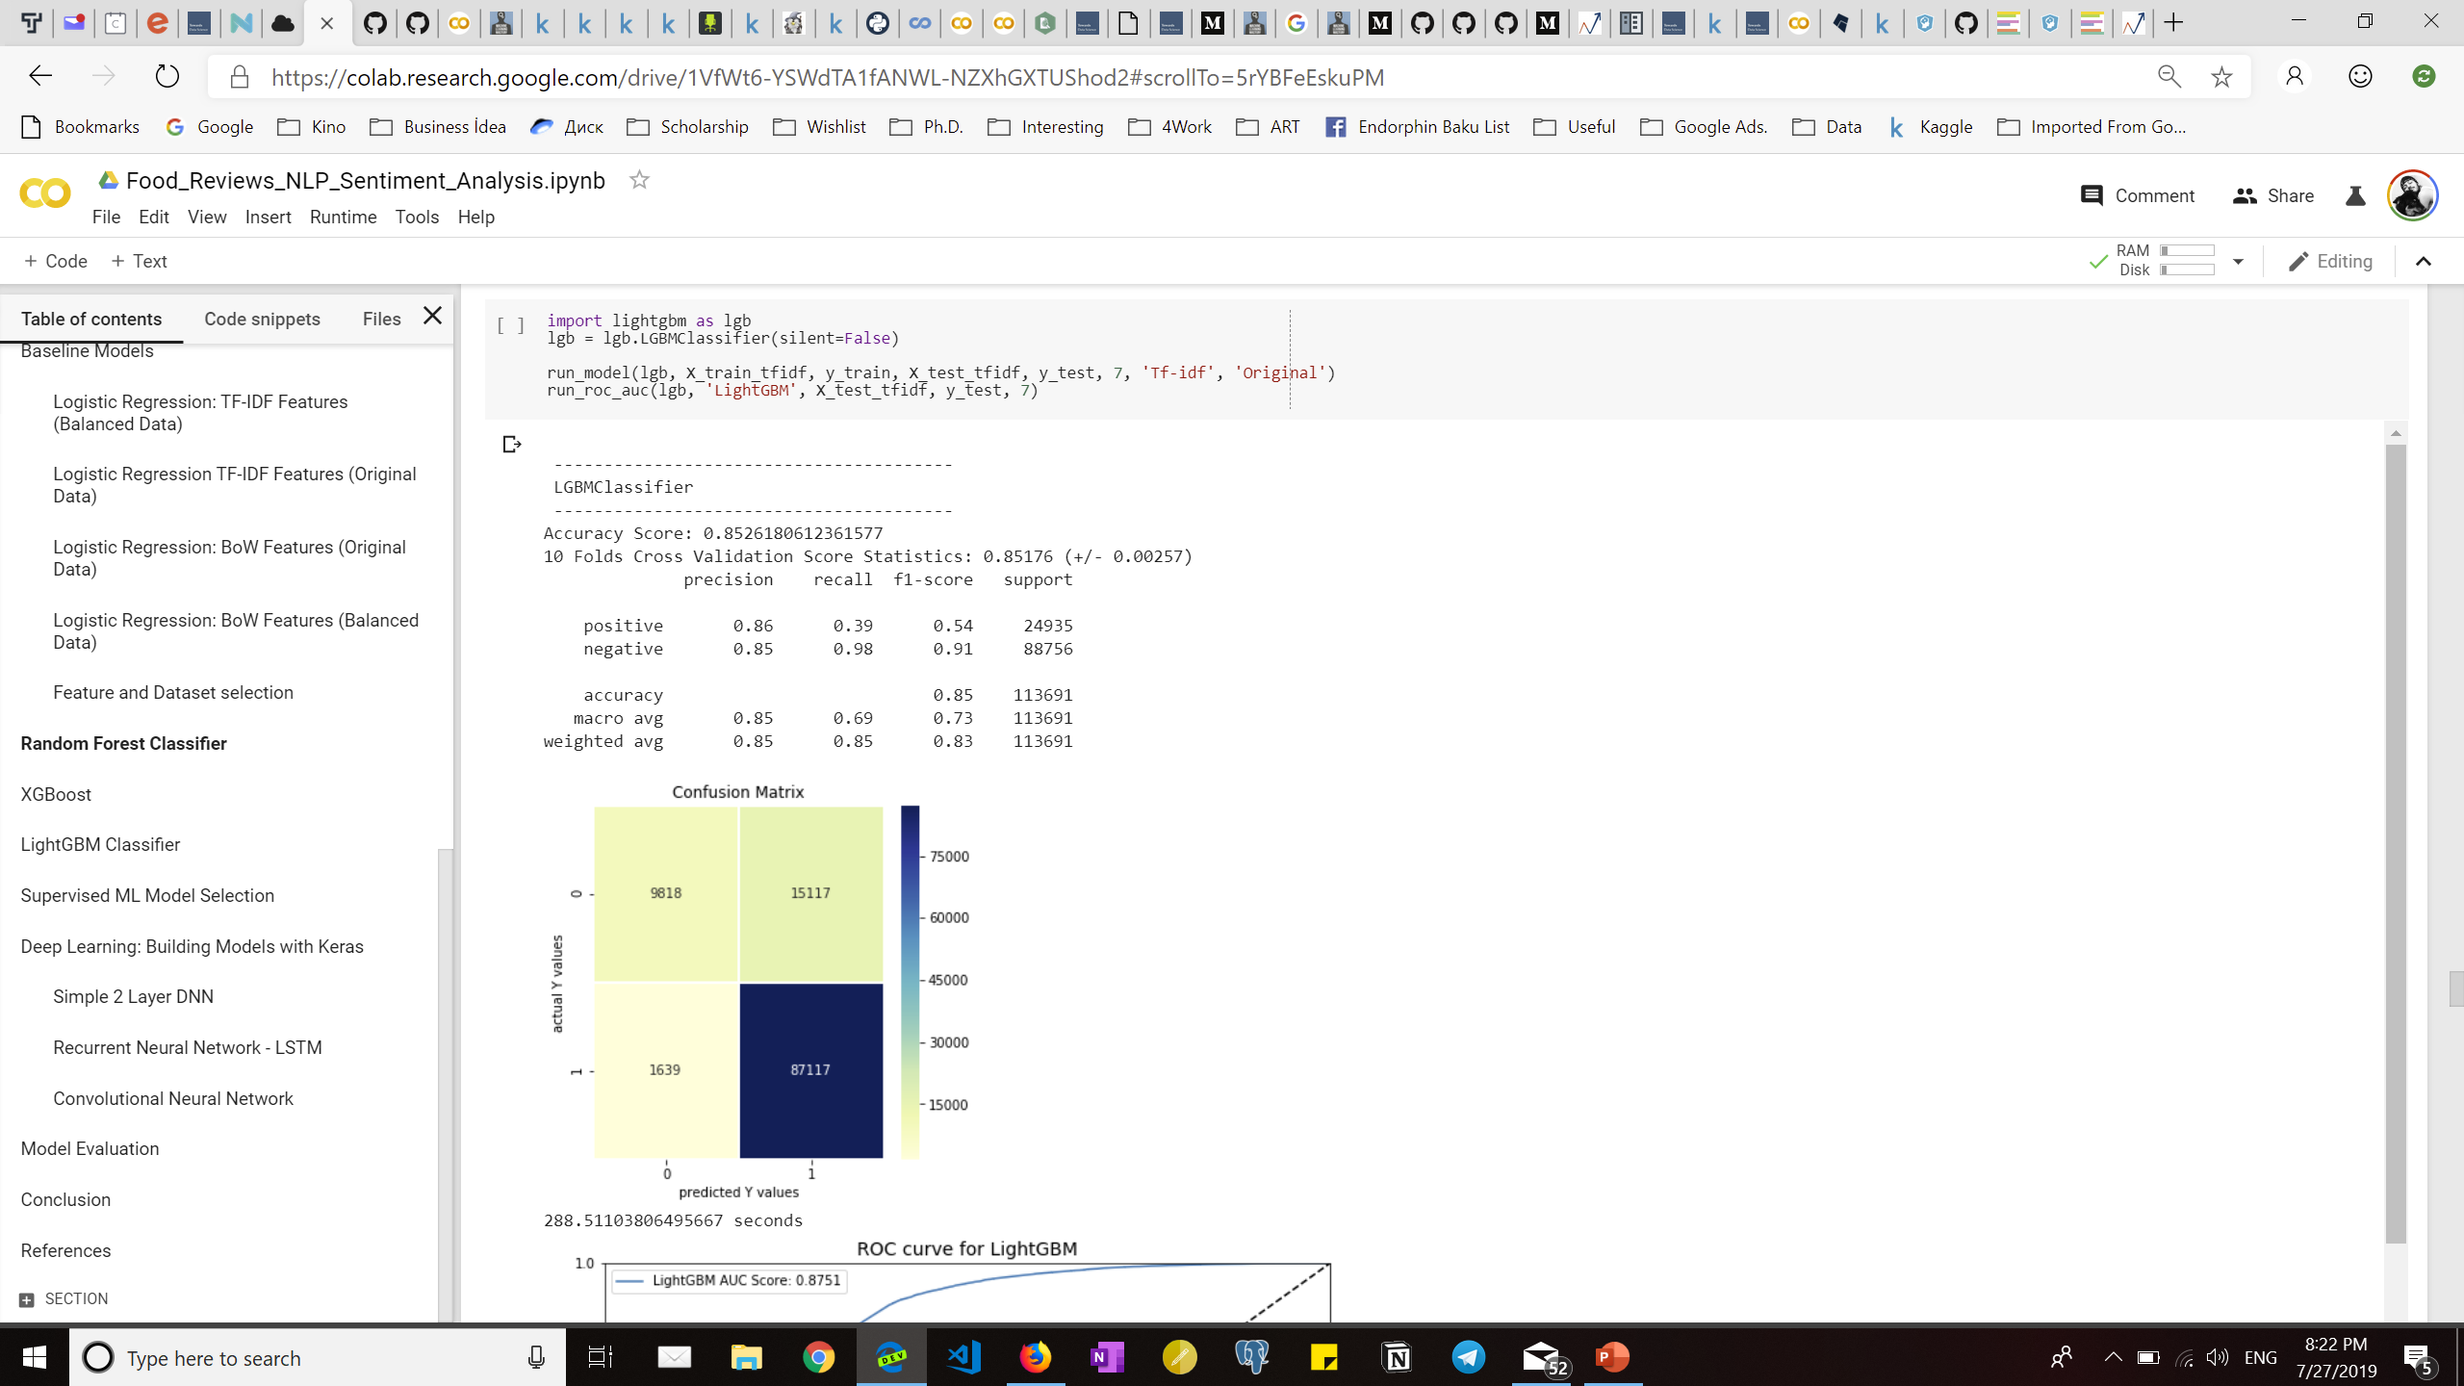
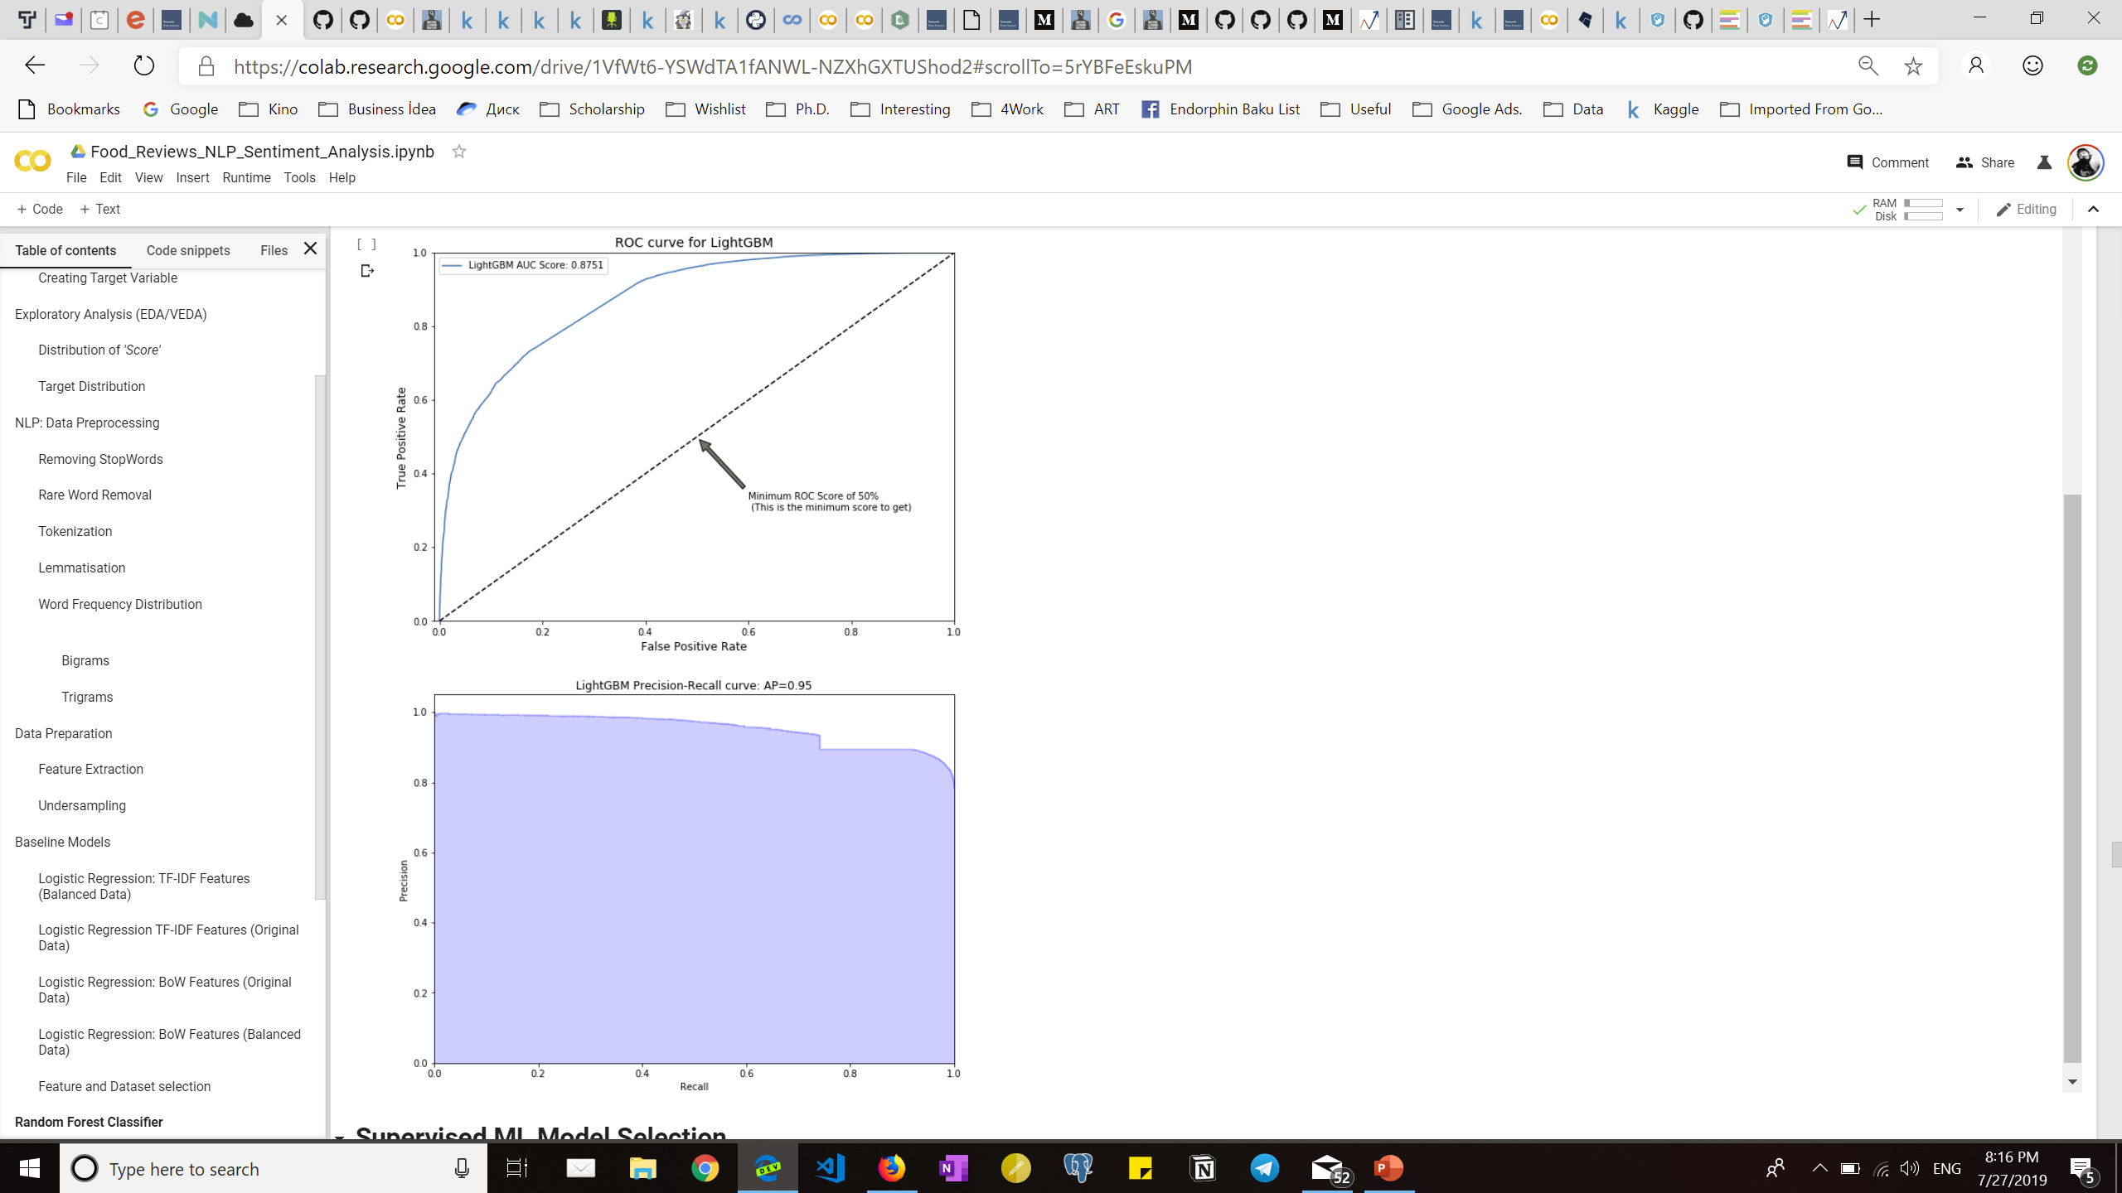
Lightgbm classifier

Slide 28
Deep learning with keras

Slide 29
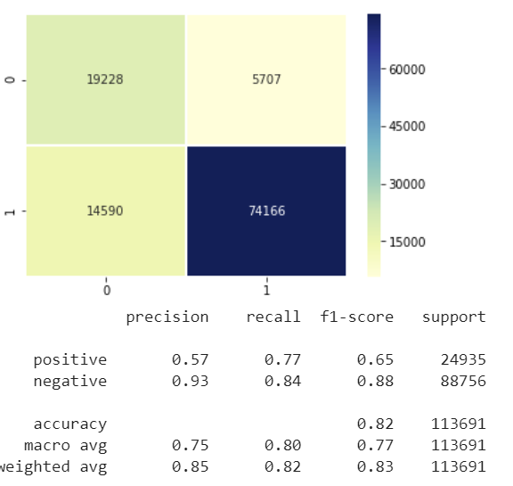
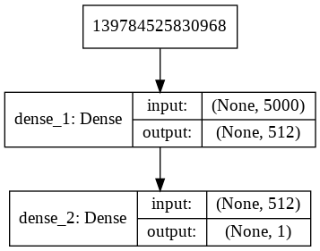
2 layer simple dnn

Slide 30
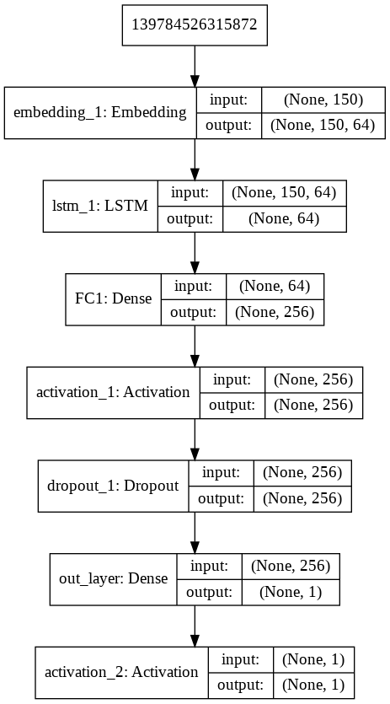
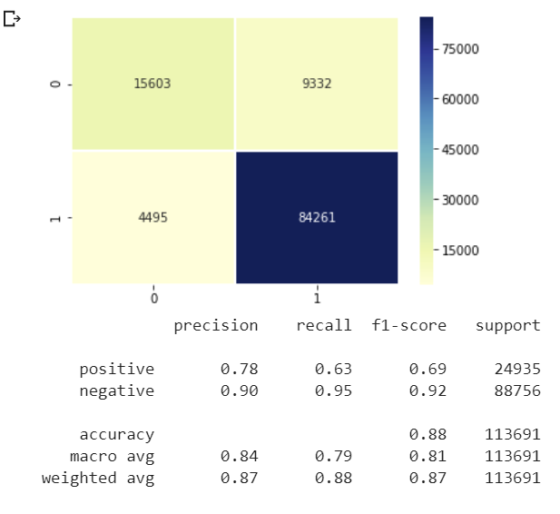
RNN-LSTM

Slide 31
Cnn

Slide 32
Result table
Model | Accuracy | AUC Score | Runtime
LogisticRegression | 0.8705 | 0.9024 | 0.94
RandomForestClassifier | 0.8714 | 0.8855 | 3.9
XGBClassifier | 0.8106 | 0.7998 | 3.3
LGBMClassifier | 0.8526 | 0.8751 | 4.8
DNN | 0.8697 | 0.8891 | 4.1
RNN | 0.8851 | 0.9144 | 94.5
CNN | 0.8414 | 0.8801 | 2.6

